Slide 1



DEPENDENCY BASED ATTACKS ON Node.js (AITB09)
INFORMATION TECHONOLOGY
V SEMESTER – R18
2021 - 22
Prepared by:
Mr. A Krishna Chaitanya
Assistant Professor, IT

Slide 2




MODULE-I
Dependency Based Attacks on Node js

Slide 3
Node.js
Node.js is a popular open source server-side run-time platform for JavaScript applications.
Node.js applications use third-party JavaScript modules as dependencies.
The community shares and distributes these modules through the Node Package Manager (NPM) repository.
The NPM lists about 500.000 packages;1 thus, it is the largest language-specific package manager.

Slide 4
The number of dependencies, which are often third-party dependencies available in NPM, of a typical Node.js application can easily exceed several hundred.
The installation of all dependencies is a prerequisite for running the application.
Node.js dependencies have the same access level to the environment as the main application.

Slide 5
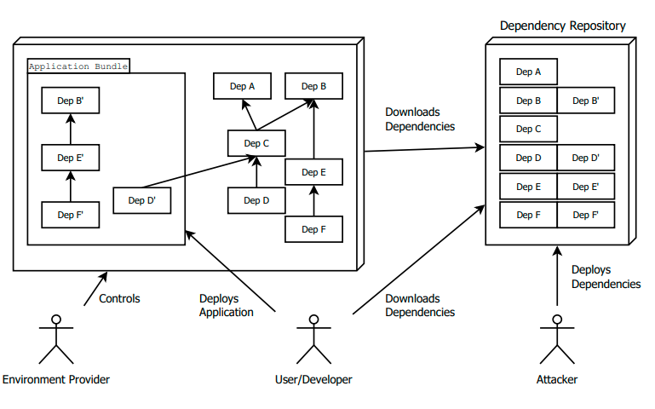
Parties involved in Dependency based attack scenario

Slide 6
A user of the environment deploys an application bundle that includes all dependencies but also uses pre-deployed libraries managed by the environment provider.
An attacker could use the dependencies to stage an attack on target Node.js applications
Use of third-party dependencies allows for potential attacks because dependencies could be controlled by attackers

Slide 7

Comparison of dependency-based attacks in terms of their specific properties and underlying flaws.
 | Scope | Aims for | Source | Source
Global Leakage | Global | Data | JavaScript | Global variable
Global Manipulation | Global | Data & Control | JavaScript | Global variable and monkey-patching
Local Manipulation | Local | Data & Control | Node.js | Loaded module cache and monkey-patching
Dependency Tree Manipulation | Local | Data & Control | Node.js | Loaded module cache and monkey-patching

Slide 8
DEPENDENCY-BASED ATTACKS
1. Weaknesses
Global variable. The JavaScript language functionalities are realized in functions and variables (aka objects) that are stored in the global namespace/scope
The elements of the global namespace are shared among all the modules of the given Node.js application including their dependencies.
The use of global variables is considered a bad practice

Slide 9
DEPENDENCY-BASED ATTACKS
2. Dependency attacks
Global leakage A dependency could access global variables and leak their content. To do so, it needs to implement a leak()-like function that sends the provided parameter.
Global manipulation The key idea of this attack is to manipulate a globally accessible variable or function to alter the application behavior. For instance, the behaviour of a function could be changed using monkey-patching.
Local manipulation. Variables in Node.js could have a local scope that is accessible within the context of the caller, not from outside as in global variables.
Dependency-tree manipulation It is possible to use the cache object of the require function directly rather than manipulating the object returned by the require function, as in the previous attack.

Slide 10
MITIGATION OF DEPENDENCY-BASED ATTACKS
Mitigation strategies
The first mitigation strategy for this category of attacks is to perform code review of all dependencies, which is time consuming. Manual code review is not practical when updated versions of these dependencies should be adopted frequently.
The second mitigation strategy is to address the three weaknesses discussed; however, these weaknesses are design choices. Design changes, such as changing the cache mechanism of Node.js, may be made to address the weaknesses. However, such design changes would break existing applications.
The third strategy, which is more realistic, is to use static code analysis t detect these attacks, which we adopted. Next subsections discuss our implementation.

Slide 11
Static code analyses for dependency-based Attacks
Global leakage The identification criterion for this attack is: invoke a leaking function where one of the parameters is a global variable. The problem with this attack is the difficulty to enumerate all the leaking functions–this is easier in the case of Android as Apps need to call specific system services
Global manipulation There are two varieties for this attack: (1) a global object is overwritten or (2) any of its properties is modified. The first variety is easy to detect. In WALA, overwriting a global variable is represented by a single IR AstGlobalWrite instruction. If an IR instruction is of type AstGlobalWrite and the variable is a built-in JavaScript global variable, then an attack is found.

Slide 12
Static code analyses for dependency-based Attacks
Local manipulation The identification criteria of the attack are the dependency is loaded using function require in the scope of a module and manipulated in the scope of another module. To detect such attack, we first identify all invocations of require function, considering that function names can be parameters for other functions. Next, a data flow analysis is performed over loaded objects and manipulations of the objects or of their properties are identified; that is, we track IR instructions JavaScriptPropertWrite and SSAPutInstruction.
Dependency-tree manipulation The identification criterion of the attack is: the interface of a dependency is manipulated in the scope of another module without loading it or the dependency module is replaced by another file. To detect such attack, all invocation of JavaScript statement require.cache are identified. The objects returned by these invocations are tracked using data flow analysis to check for manipulations.

Slide 13


